Slide 1
Computational and statistical learning
Project tortoli daniele

Slide 2
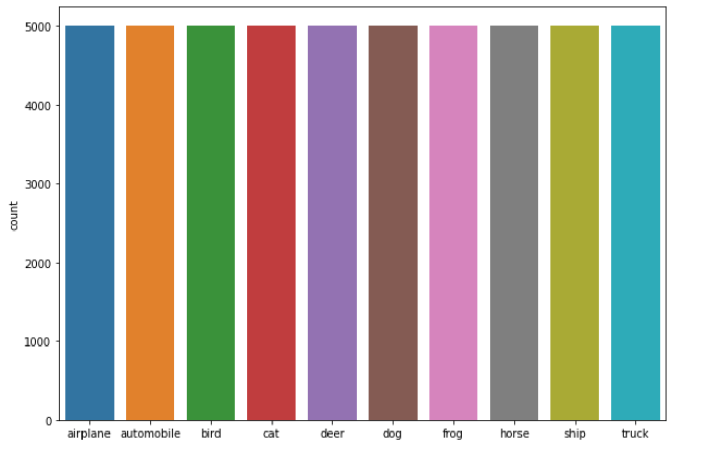
Dataset
CIFAR 10
60000 images: 50000 for training, 10000 for test.
10 classes, 5000 images for class.

Slide 3
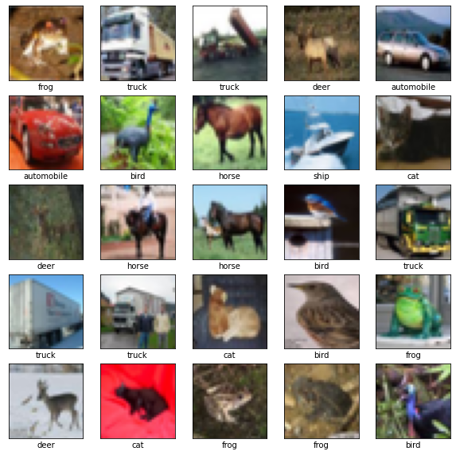
SOME EXAMPLEs OF THE TRAINING SET
RGB imgs
32 x 32 x 3

Slide 4
TESTED METHODS
PCA
LOGISTIC REGRESSION:
LASSO
RIDGE
KMEANS
CNN
GAN
VAE

Slide 5
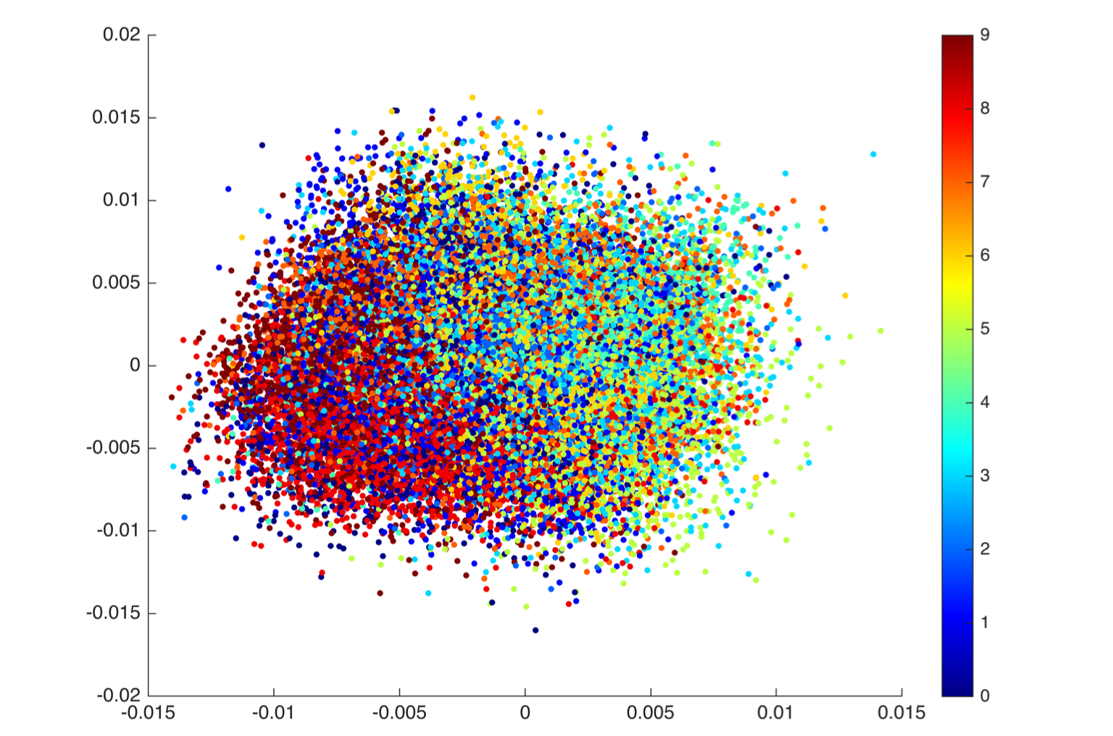
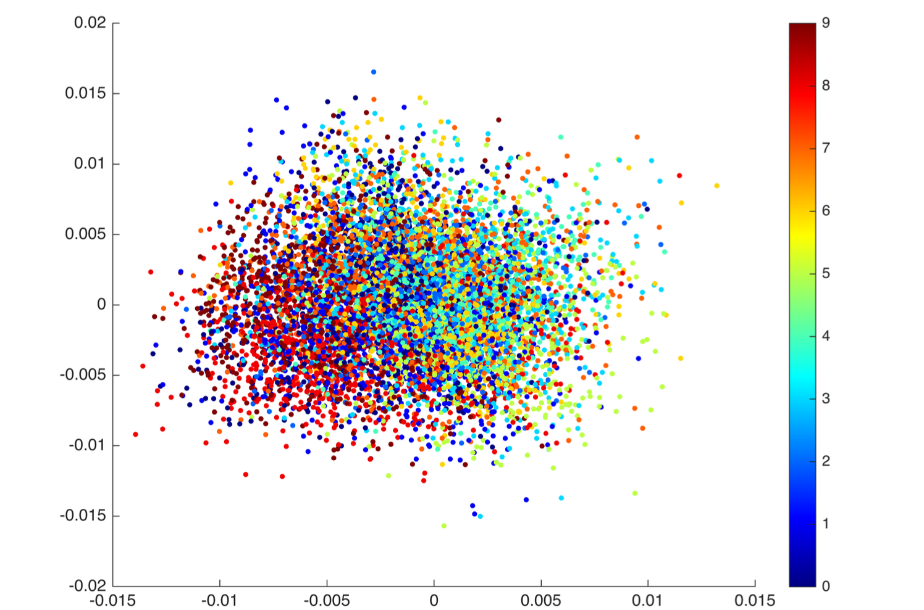
PCA 1/2
Hyperparameters:
k : components that you want to preserve
k = 2 to see training and test distribution

Slide 6
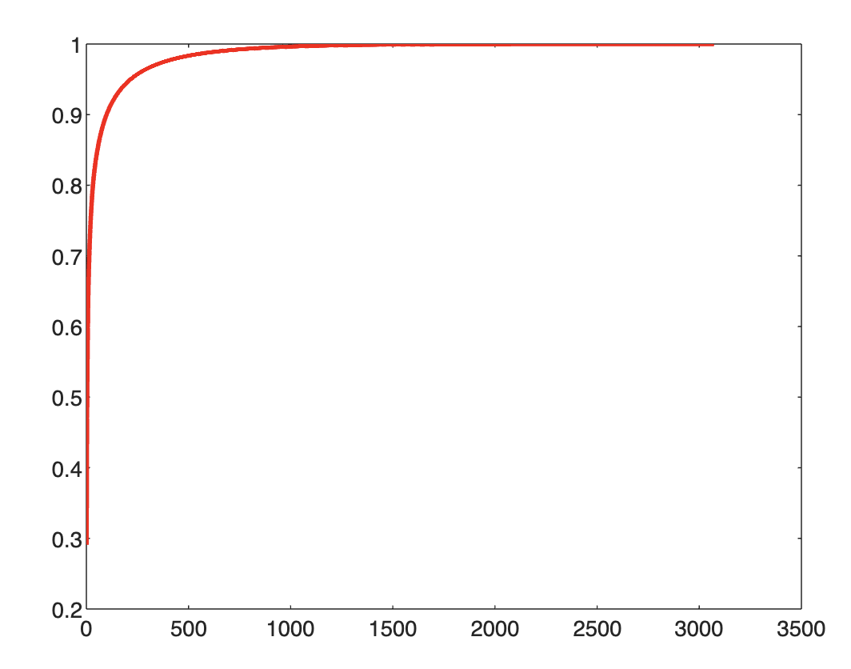
PCA 2/2
k = 33 80% info
k = 55 85% info
k = 99 90% info
k = 217 95% info
k = 658 99% info
k = 3072 The entire dimension

Slide 7
COMPARISON - ACCURACY
# COMPONENTS | FICTREE | LASSO | RIDGE
k = 33 | 0.2920 | 0.3439 | 0.3837
k = 55 | 0.2890 | 0.3491 | 0.3614
k = 99 | 0.2802 | 0.3619 | 0.3495
k = 217 | 0.2743 | 0.10 | 0.10
k = 658 | 0.2586 | 0.10 | 0.10
The whole dataset | 0.2683 | 0.3027 | 0.2754

Slide 8
K-means
# COMPONENT | ACCURACY
k = 33 | 0.0462
k = 55 | 0.0606
k = 99 | 0.0941
k = 217 | 0.1111
k = 658 | 0.0852
The whole dataset | 0.0751
K-MEANS algorithm was performed on the entire dataset but with very poor results.

Slide 9
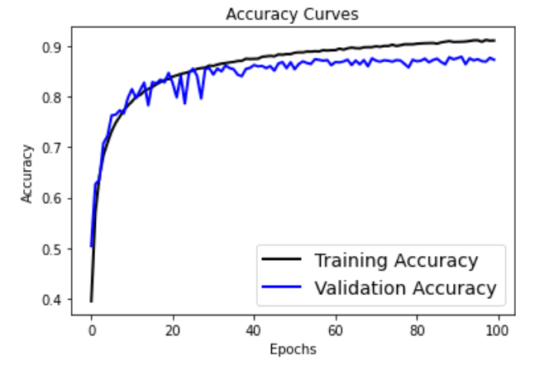
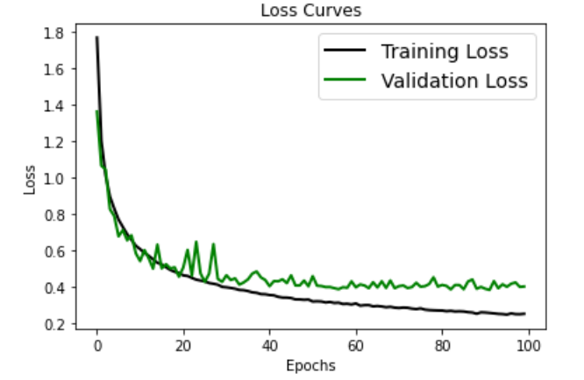
Cnn 1/2
CNN suits well for this type of classification

Slide 10
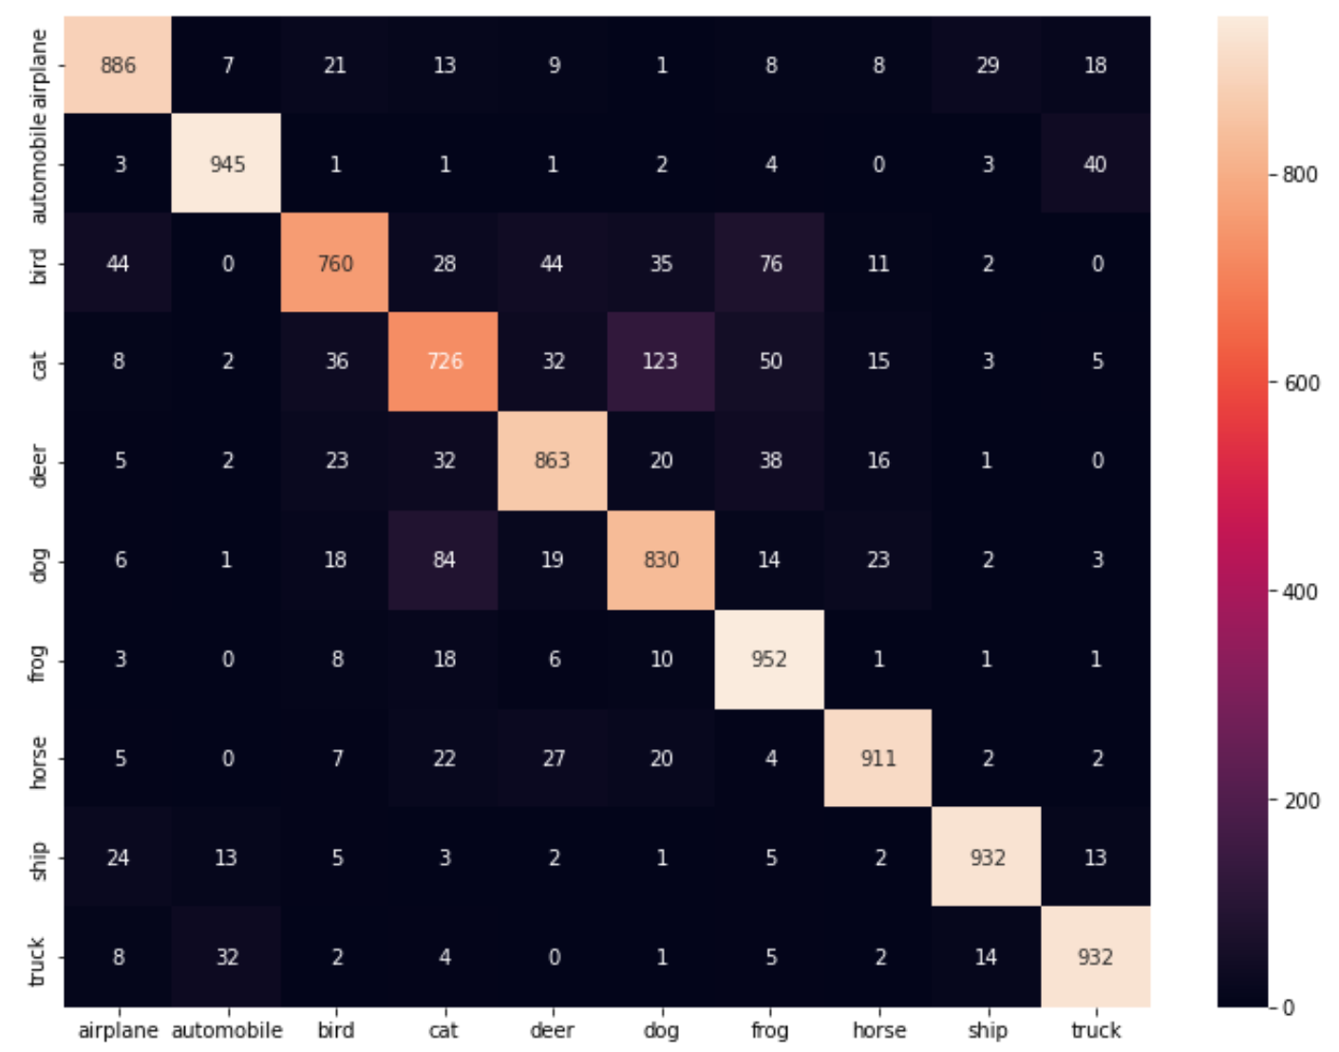
Cnn 2/2
Accuracy achieved: 0.8737

Slide 11
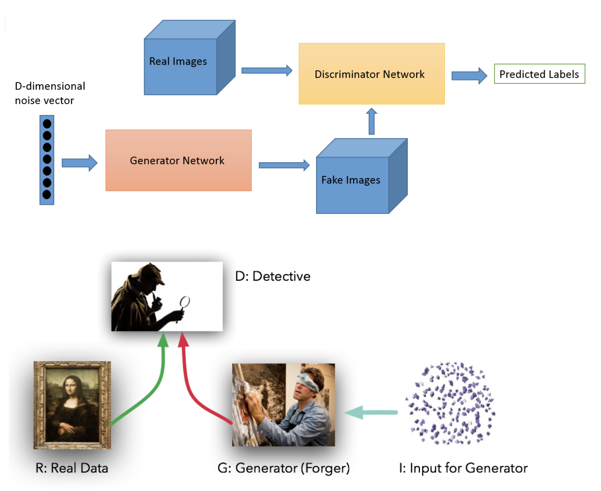
GENERATIVE MODELS: GAN 1/2

Slide 12
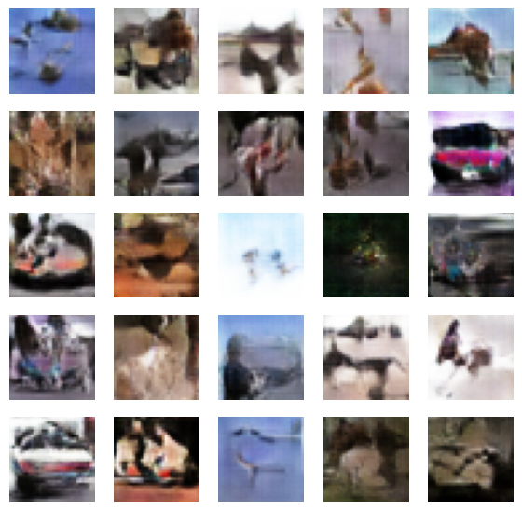
GENERATIVE MODELS: GAN 2/2

Slide 13
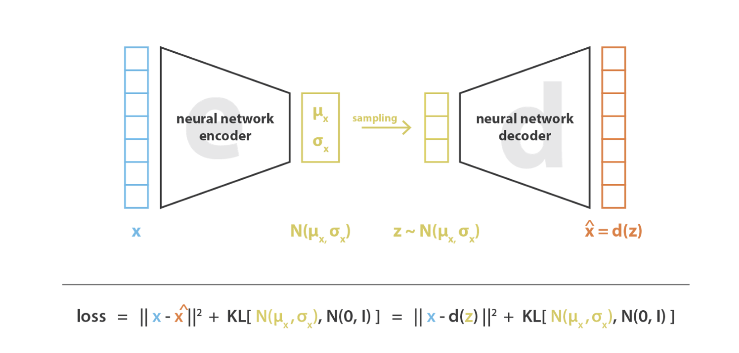
GENERATIVE MODELS: VAE 1/3

Slide 14
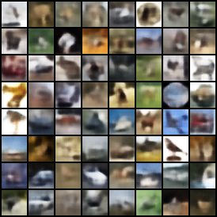
GENERATIVE MODELS: VAE 2/3 rECONSTRUCTION

Slide 15
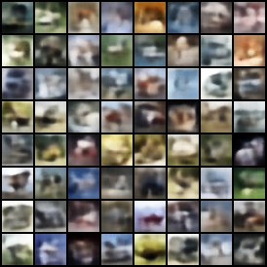
GENERATIVE MODELS: VAE 3/3 generation

Slide 16
THE end

